Slide 1
Security Measures
Lecture 09

Slide 2
Basic Security Concepts
Threats :
A threat is a possible danger that might exploit a vulnerability/fragility to breach security and therefore cause possible harm.
Degrees of harm
Level of potential damage
Include all parts of system
Potential data loss
Loss of privacy
Inability to use hardware
Inability to use software
Countermeasures
Steps taken to block a threat
Protect the data from theft
Protect the system from theft

Slide 3
Threats To Users
Identity Theft
Loss of Privacy
Cookies
Spywares
Web Bugs
Spams

Slide 4
Threats To Users
Identity Theft
Identity Theft is when someone illegally obtains personal information about someone else for the purposes of impersonating them. This is often done for financial gain by creating debt for the victim, but can also be used to commit crimes using the assumed identity.

Slide 5
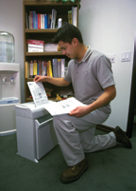
Threats To Users
Avoiding Identity Theft
Guard your papers
Shred unneeded papers
Pick up you mail quickly
Check statements immediately
Keep records for 3 years
Guard your personal information
Be wary giving out information
Avoid giving account numbers
Never give personal information in e-mail
Ensure online shopping is secure
Look at the big picture
Review your credit report yearly
Develop an efficient filing system
Know your liability limits

Slide 6
Threats To Users
Loss of privacy
Personal information is stored electronically
Purchases are stored in a database
Data is sold to other companies
Public records on the Internet
Internet use is monitored and logged
None of these techniques are illegal
Avoiding Loss of Privacy:
Keep marketers at bay
Be cautious filling out forms
Guard your primary email address
Have a ‘spam account’ for forms
Know your legal rights
1966 Freedom of Information Act
1970 Fair Credit Reporting Act
Privacy Act of 1974
1986 Electronic Communications Act

Slide 7
Threats to Users
Cookies
Files delivered from a web site
Originally improved a site’s function
Cookies now track history and passwords
Browsers include cookie blocking tools
Avoiding Cookies
Dealing with cookies
Browsers provide settings to block cookies
No cookies to all cookies allowed
Without cookies some sites crash
Cookies can be deleted
Cookie types
Session cookies: Cookies for the current site
Persistent cookies: Stored on hard drive until deleted
First-party cookies: Installed by the current site
Third-party cookies: Installed by an ad

Slide 8
Threats to Users
Spyware
Software downloaded to a computer
Designed to record personal information
Typically undesired software
Hides from users
Web bugs
Small programs embedded in gif images
Gets around cookie blocking tools
Companies use to track usage
Removing web bugs and spyware
Install a spyware removal program
None are 100% effective, use two
Install a pop-up blocker
Are extremely effective
Blocked with spyware killers

Slide 9
Threats to Users
Spam
Unsolicited commercial email
Networks and PCs need a spam blocker
Stop spam before reaching the inbox
Spammers acquire addresses using many methods
Evading spam
Contact your ISP
Use mail program’s filters
Use an anti-spam program
Use an online account for purchasing

Slide 10
Protecting Your System
Limit physical access
Easiest way to harm or steal data
Build an account for each user
Require a password for access
Software and hardware password
Use a firewall
Protects from unauthorized remote use
Makes your computer invisible
Cost between $0 and $80
Backup often
Backup is a copy of a file
Restore replaces a file on disk
Organizations backup at least daily
Home users should backup weekly

Slide 11
Cyber Security

Slide 12
Cyber Security
Contents
Introduction
Categories of Cyber Crime
Principles of Computer Security
Types of Cyber Crime
Types of Cyber Attack by Percentage
Cyber Threat Evolution
Advantages of Cyber Security
Safety Tips to Cyber Crime

Slide 13
Introduction
Cyber Crime committed using a computer and the internet to steal a person’s identity or illegal imports or malicious programs. Cyber crime is an activity done using computers and the internet.
Cyber security refers to the technologies and processes designed to protect computers, networks and data from unauthorized access and attacks delivered via the internet by cyber criminals. Though, cyber security is important for the network, data and application security.
The objective of cyber security is to establish rules and measure to use against attacks over the internet.

Slide 14
Categories of Cyber Crime
We can categorize cyber crime in two ways:-
The computer as a target: Using a computer to attacks other computer e.g. Hacking, Virus/Worms attacks, DoS attack etc.
The computer as a weapon: Using a computer to commit real world crime e.g. credit card fraud etc.

Slide 15
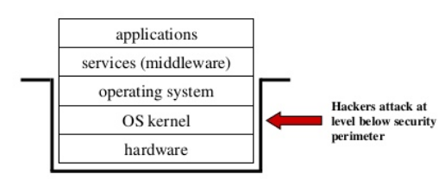
Principles of Computer Security
How do you stop an attacker from getting access to a layer below your protection mechanism?
Every protection mechanism defines a security perimeter (boundary). Attackers try to bypass protection mechanisms.

Slide 16
Types of Cyber Crime
Hacking
Phishing
Denial of Service
Spam Email
Spyware, Adware
Malware (Trojan, Virus, Worms etc. )
ATM Skimming and Point of Scale Crimes
Ransomware

Slide 17
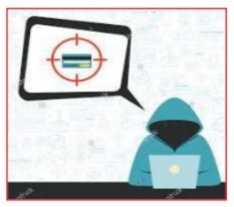
Hacking
Hacking in simple terms means an illegal intrusion into a computer system and/or network.
It is also known as cracking. Government websites are the hot targets of the hackers due to the press coverage, it receives.

Slide 18
Phishing
Phishing is a fraudulent attempt, usually made through email, to steal your personal information.
Phishing is the attempt to obtain sensitive information such as username, password and credit card details, often for malicious reasons through an electronic communication (such as E-mail).
A common online phishing scam starts with an email message that appears to come from a trusted source (legitimate site) but actually directs recipients to provide information to a fraudulent web site.

Slide 19
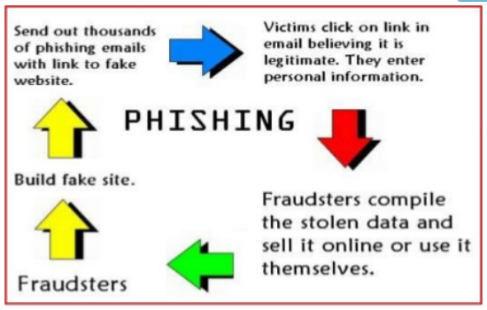
Phishing

Slide 20
Denial of Service
This is an act by the criminals who floods the Bandwidth of the victims network.
In the DoS attack, a hacker uses a single internet connection to either exploit a software vulnerability or flood a target with fake request-usually in an attempt to exhaust server resources.
On the other hand, DDoS attacks are launched from multiple connected devices that are distributed across the internet.
DoS = When a single host attacks.
DDoS = when multiple hosts attack simultaneously and continuously.

Slide 21
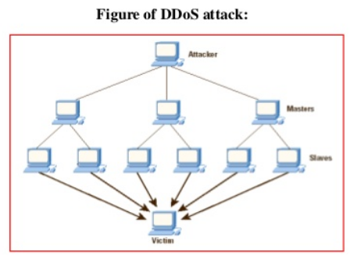
Denial of Service

Slide 22
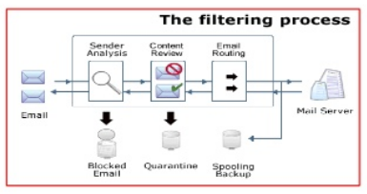
Spam Email
Email Spam is the electronic version of junk mail. It involves sending unwanted messages, often unsolicited advertising, to a large number of recipients. Spam is a serious security concern as it can be used to deliver Trojan horses, viruses, worms, spyware, and targeted phishing attacks.

Slide 23
Malware
It’s malicious software ( such as Virus ,Worms & Trojan ) , which specifically designed to disrupt or damage computer system or mobile device.
Hackers use malware for any number of reasons such as, extracting personal information or passwords, stealing money, or preventing owners from accessing their device.
Viruses are programs that attach themselves to a computer or a file and then circulate themselves to other files and to other computers on a network. They usually affect the data on a computer and mobile device either by altering or deleting it.

Slide 24
Malware
Worms unlike viruses do not need the host to attach themselves. They merely make functional copies of themselves and do this repeatedly till they eat up all the available space on the computer’s memory.
Trojan is a type of malware that pretends to be something useful, helpful, or fun while actually causing harm or stealing data. Trojans are often silently downloading other malware (e.g. spyware, adware, ransomware) on an infected device as well.
Trojans can infect you in places where you might not expect it, such as emails, downloads and more. It's always better to be safe than sorry when it comes to avoiding this type of malware.

Slide 25
Malware
Spyware
Spyware is a type of malware that hackers use to spy on you in order to gain access to your personal information, banking details, or online activity. We should protect ourselves by an anti-spyware tool.
Adware
Adware is a type of malware that bombards you with endless ads and pop-up windows that could potentially be dangerous for your device. The best way to remove adware is to use an adware removal tool.

Slide 26
Malware
Ransomware
Ransomware is as scary as it sounds. Hackers use this technique to lock you out of your devices and demand a ransom in return for access. Ransomware puts you in a sticky situation, so it's best to know how to avoid it.
Ransomware (a.k.a. rogueware or scareware) restricts access to your computer system and demands that a ransom is paid in order for the restriction to be removed. The most dangerous ransomware attacks are caused by Wannacry, Petya, Cerber and Locky ransomware. The money which suppose to be paid to remove ransomware from your system which is called ransom money.
Current affairs: eg. WannaCrypt , Petya Variant

Slide 27
ATM Skimming and Point of Scale Crimes
It is a technique of compromising the ATM machine by installing a skimming device a top the machine keypad to appear as a genuine keypad or a device made to be affixed to the card reader to look like a part of the machine.
Additionally, malware that steals credit card data directly can also be installed on these devices. Successful implementation of skimmers cause in ATM machine to collect card numbers and personal identification number codes that are later replicated to carry out fraudulent transaction.

Slide 28
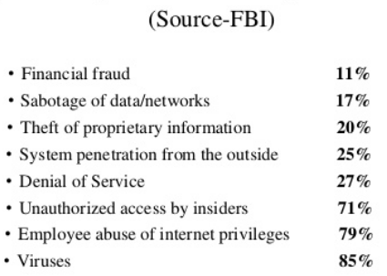
Types of Cyber attack by percentage

Slide 29
Advantages of Cyber Security
It will defend us from hacks and virus. It helps us to browse the safe website.
Internet Security process all the incoming and outgoing data on our computer.
The cyber security will defend us from critical attacks.
The application of cyber security used in our PC needs update every week.
The security developers will update their database every week once. Hence the new virus also detected.

Slide 30
Safety Tips to Cyber Crime
Use Antivirus Software.
Insert Firewalls.
Uninstall unnecessary software.
Maintain backup.
Check security settings.
Never give your full name or address to strangers.
Learn more about the internet privacy.

